Slide 1
HOLIDAY
name: Martina Brnická
Classe:VI.A.

Slide 2
I was on holiday in winter with my parents and my brother. We were on High Tatras at Tatranska Lomnica.
We stayed on hotel names Sasanka.

Slide 3
I got new skis Dynastar. We were not ski because it was not snow.
I experience a concert there. Featured to life a Fragile.
The weather was entirely good,but there was a cold holiday.

Slide 4
We were there for eight days.
I experience a lot of thinks.
I had a good.
There is a photos:

Slide 6
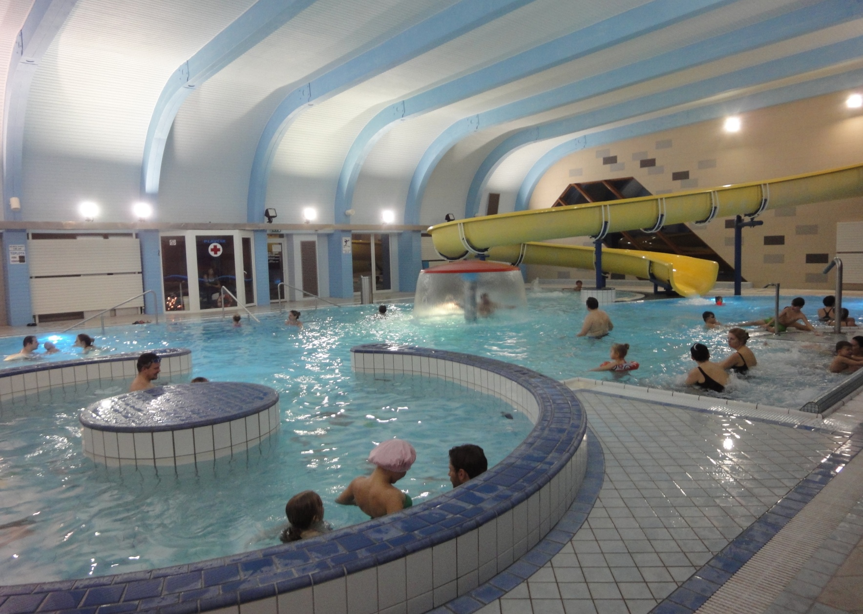
We were on aquacity Sorea titris:

Slide 7
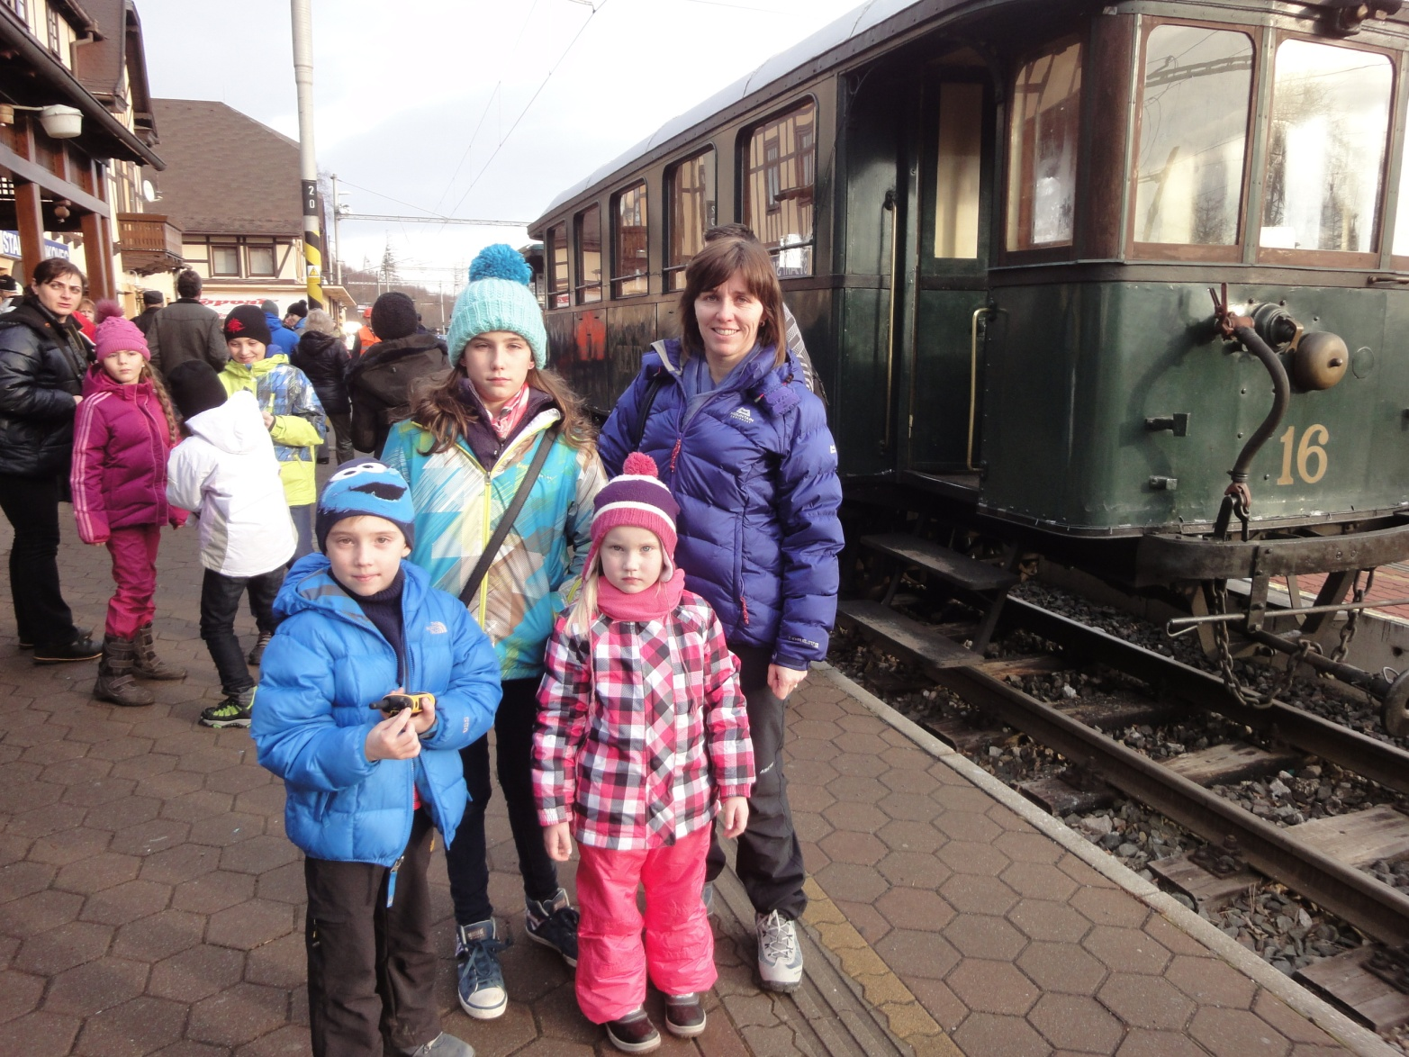
We traveled by old train,,KOMETA“:

Slide 8
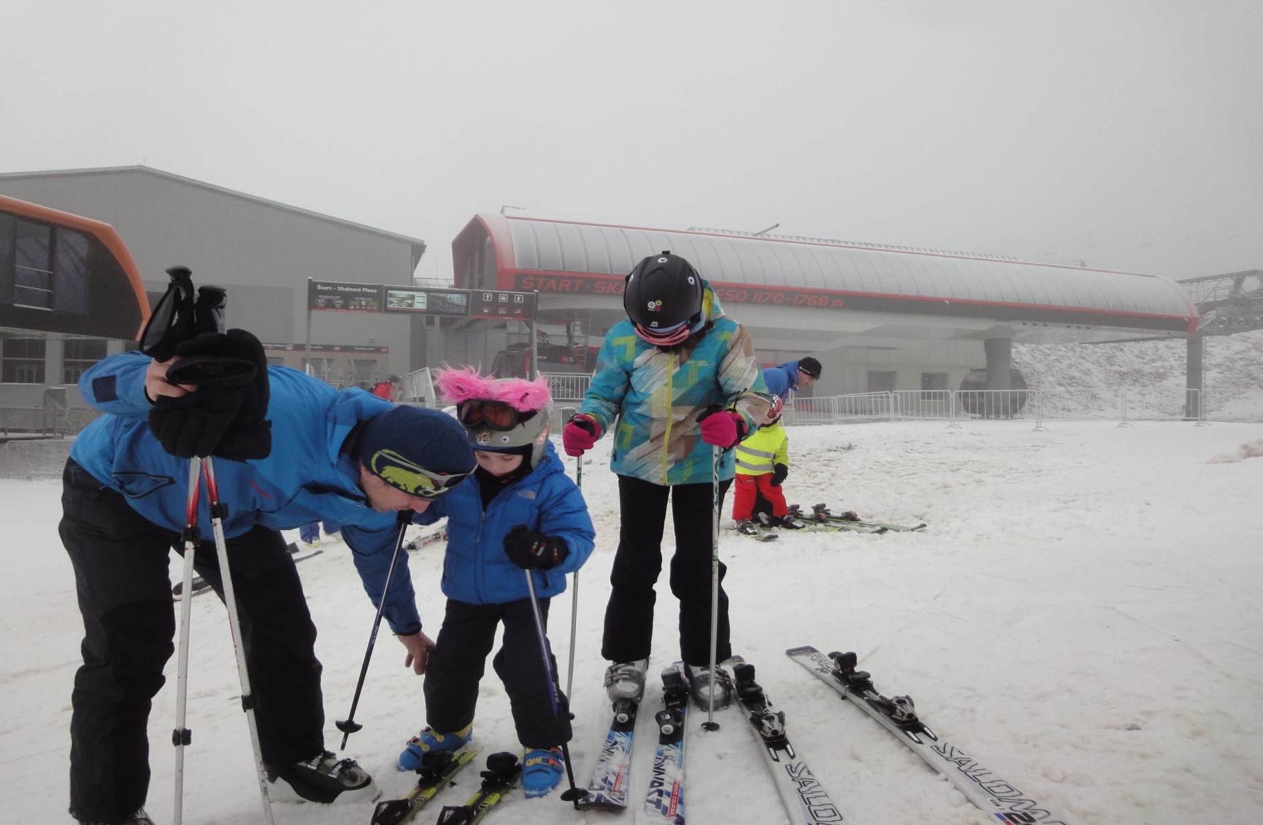
„ski“

Slide 9
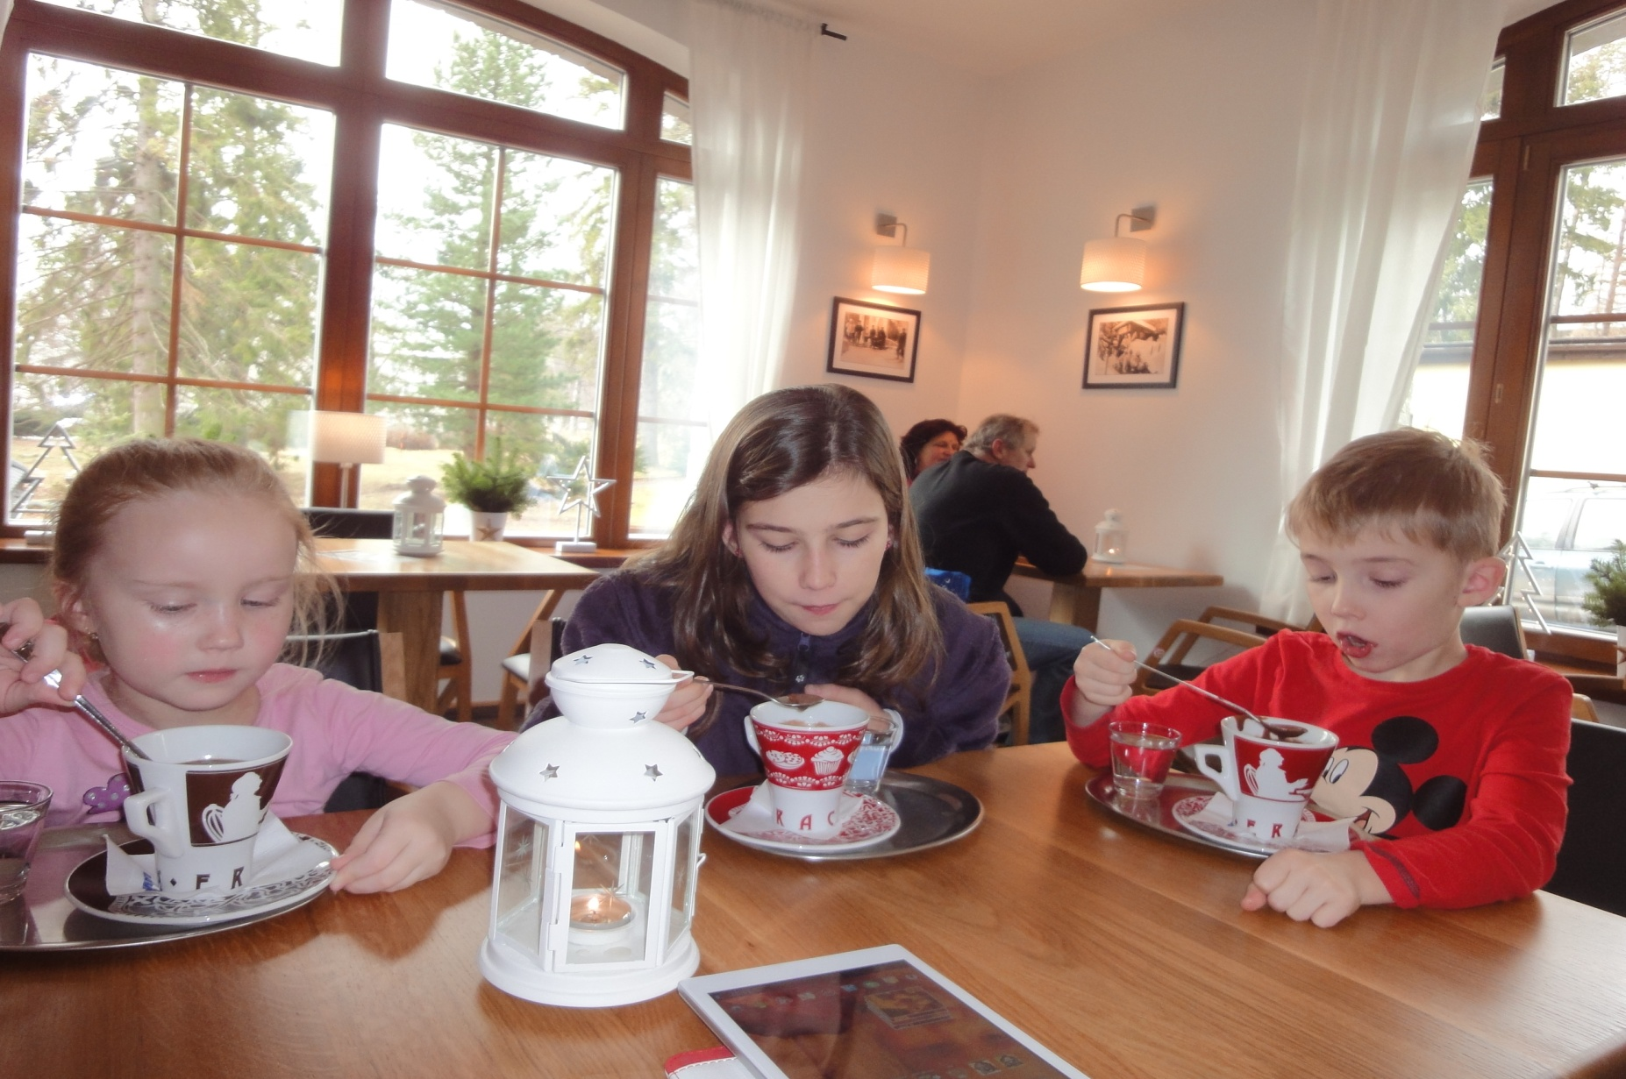
And hot chocolate

Slide 10
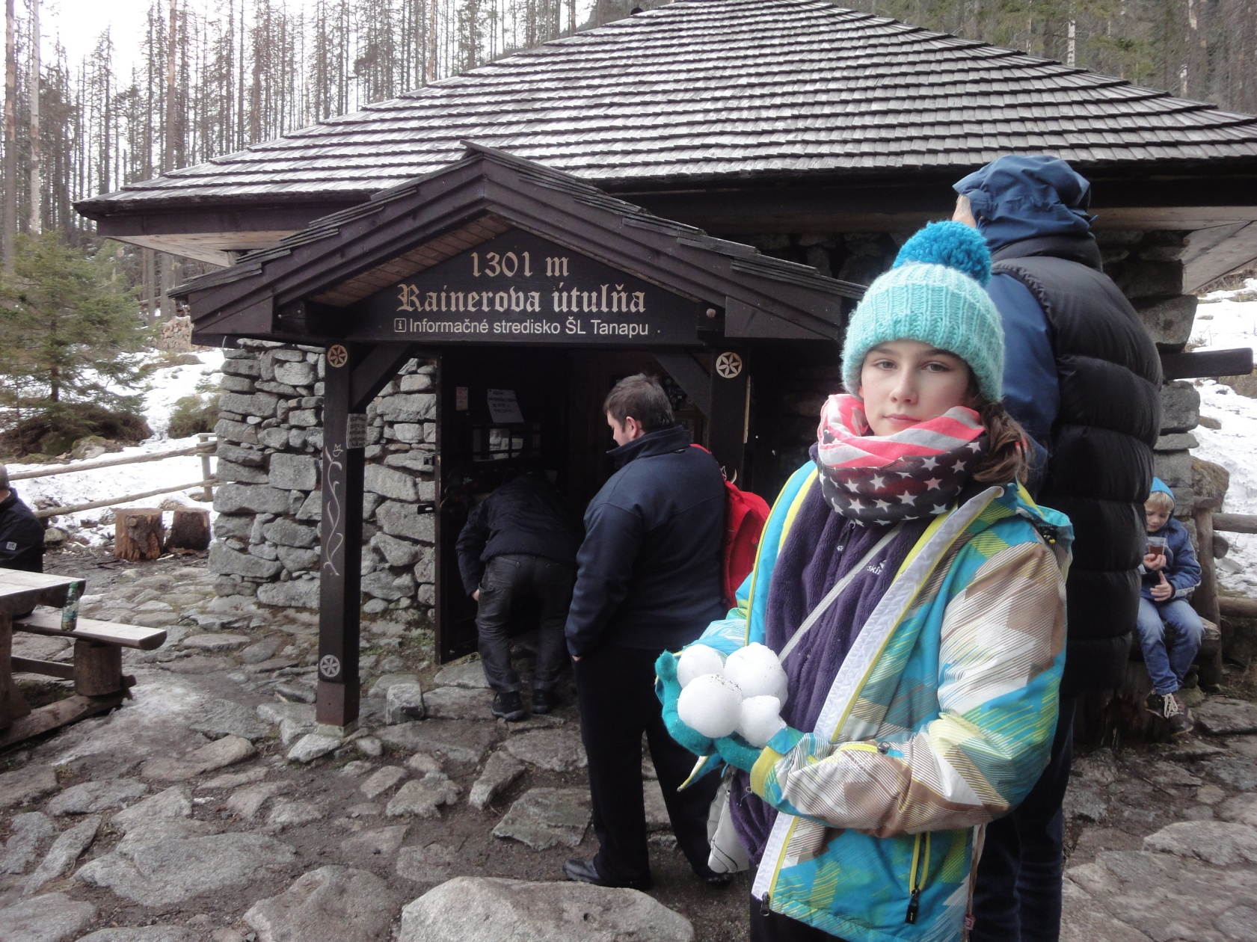
We were on trip. Reinerova and Zamkovskeho chalet.

Slide 11
